Slide 1

Analysis of the Factors Influencing Standardized Readmission Ratio (SRR) at Dialysis Facilities in the United States
Nicholas Milikich

Slide 2
Background
Dialysis centers perform hemodialysis for kidney disease patients
Severe disease, numerous comorbidities, frequent hospitalizations
30-day hospital readmissions
Age, gender, ability, biological markers, etc.
Facility level: Standardized readmissions ratio (SRR)
Pay-for-performance measure for Medicare/Medicaid
Notes:
Patients with chronic kidney failure (CKF) or end-stage renal disease (ESRD) must undergo hemodialysis several times per week, a treatment that filters wastes from the blood and can be performed either at home or in a dialysis center (Romancito, 2018). However, the severity of the disease means that it carries numerous comorbidities, and patients are frequently hospitalized for auxiliary conditions. Patient 30-day hospital readmission rates have been analyzed to identify trends in the timing of patient readmissions and readmission diagnoses (Hickson et al., 2018), and factors that contribute to higher readmissions have been identified including age, gender, ability, biological markers, presence of specific comorbidities, and duration of time on dialysis (Hickson et al., 2018; Chan et al., 2017).
The frequency of 30-day hospital readmissions can also be assessed at the facility level. The most common such metric is the standardized readmission ratio (SRR), which is the number of hospital readmissions for patients at a facility, relative to the number that would be expected given the characteristics of the patients at that facility and overall average rates (“Report for the standardized…,” 2017). More specifically, the denominator is “the number of readmission events that would be expected if patients at that facility experienced readmission events at the national median rate for patients with similar characteristics” (“Report for the standardized…,” 2017, pg. 4).
The factors affecting hospital readmissions at the individual level have been well-characterized (Hickson et al., 2018; Chan et al., 2017); they are so well trusted, in fact, that the official SRR metric is standardized with respect to the number of hospital readmissions that might be expected among a facility’s patients given their individual comorbidity histories (“Report for the standardized…,” 2017). However, little analysis has been done into the factors that affect patient hospital readmission rates at the facility level. Such research should be of great interest: the SRR is a pay-for-performance quality measure implemented by the Centers for Medicare and Medicaid Services to incentivize a reduction in hospital readmissions (Assimon & Flythe, 2017). It is of interest to operators of dialysis facilities to understand what metrics and facility-wide practices contribute to a higher SRR in order to reduce SRR and receive greater government insurance reimbursement payments. This study applies a variety of machine learning techniques to previously compiled data on American dialysis facilities (Wang, 2018) in order to characterize the factors affecting SRR at the facility level.

Slide 3
Dataset
ESRD QIP PY 2018 + Dialysis Facility Report 2018 + …
Someone on Kaggle
58 metrics on 6,574 US dialysis facilities (Kaggle)
Cut out incomplete data, irrelevant predictors (Name, City, ZipCode, etc.)
53 metrics on 6,068 dialysis facilities
Binary SRR (≥ 1)
Binary SRR (≥ 1.2072)

Slide 4
Methods
Variable Selection
Lasso
Elastic Net
Modeling / Variable Importance
CART & Conditional Inference Tree
Random Forest
Variable Interactions
Boosting Random Forest

Slide 5
Results
Cutoff 1
Cutoff 1.2072
52 predictors
52 predictors
Lasso & Elastic Net
Lasso & Elastic Net
21 predictors
12 predictors
Notes:
The lasso performs better for variable selection, while the elastic net takes into account collinearity as well; it therefore generally provides solutions that are not as sparse as with lasso regression. The elastic net chooses 3 extra variables not chosen by the lasso. To provide a sparser model, only variables chosen by both methods were kept in the model.

Slide 6
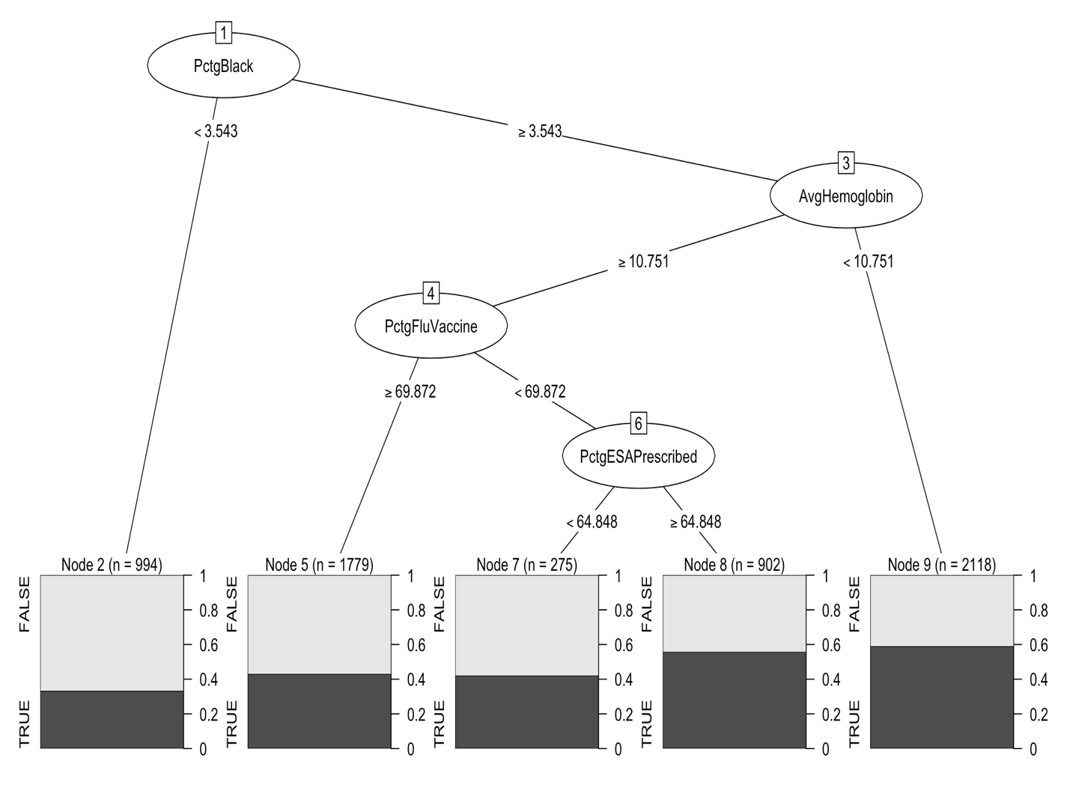
CART Cutoff 1
Accuracy 0.5920
Prop. 0’s 0.5109
PctgBlack only variable necessary to make strongest classification
Notes:
Overall, this tree does not appear to be a very strong classifier, as the most homogeneous terminal node contains less than 70% 0’s. However, it is interesting that PctgBlack is the only variable necessary to make the strongest classification, suggesting at the relative importance of this variable.

Slide 7
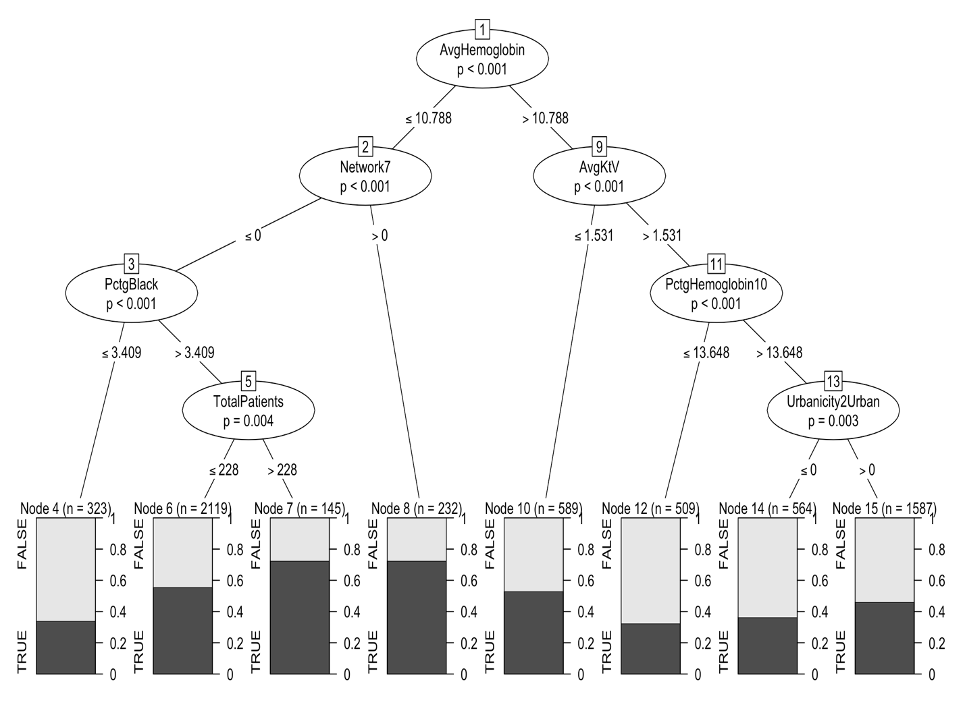
Conditional Inference Tree Cutoff 1
Accuracy 0.5819
Prop. 0’s 0.5109
Only 2/4 variables from CART appear here
Notes:
This tree appears to be a stronger classifier, as several of the terminal nodes are more homogeneous, being composed of at least 70% 0’s or 1’s; however, the performance of this tree is actually worse, with an accuracy of 0.5819. It is also notable that although this tree is larger, only 2 of the 4 variables appearing in the CART appear in this tree.

Slide 8
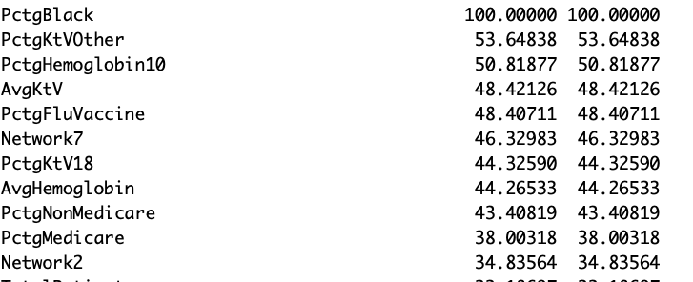
Variable Importance from CART RF Cutoff 1
etc.
Perfect classification accuracy
10-fold CV accuracy 0.5857
PctgBlack most important
Notes:
The variable importance values from running a CART random forest with cutoff 1 are shown in figure 4. This model demonstrates perfect classification accuracy, but the 10-fold cross-validated classification accuracy of 0.5857 is comparable to that of the individual trees. PctgBlack is assigned the highest variable importance score, in agreement with its demonstrated importance in the individual CART. The only other variables with VIP scores over 50 are PctgHemoglobin10 and PctgKtVOther, both biological markers.

Slide 9
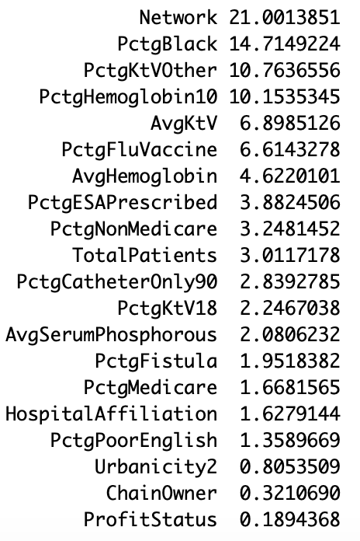
Relative Variable Influence from Boosting, Cutoff 1
Network – factor variable not selected by other algorithms
Next 6 were chosen by others
Notes:
The relative influence of each variable is shown in figure 5; the variable with the highest relative influence is Network, a geographic factor variable not yet selected by any other algorithm. The following 6 variables in terms of influence were all chosen by other methods.

Slide 10
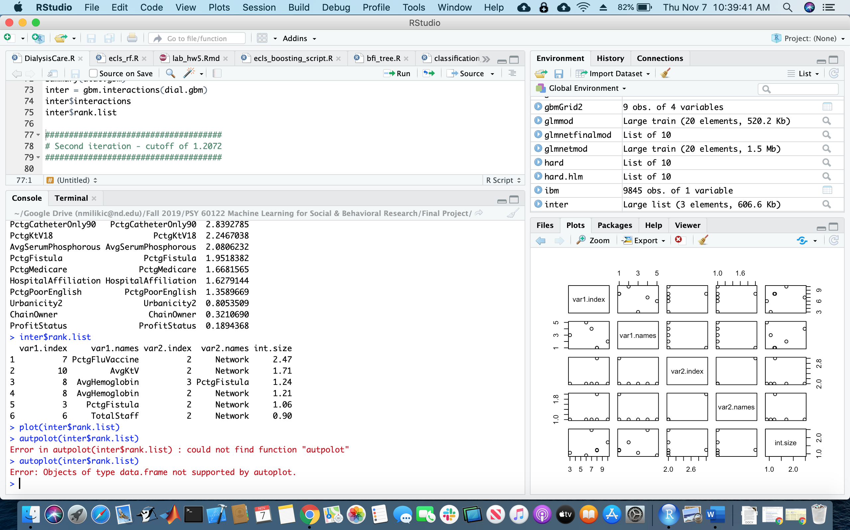
Variable Interactions from Boosting, Cutoff 1
Strong interactions between Network and 5 other variables
Consistent with high importance but absence from selection
Notes:
The variable interactions are shown in figure 6 and reveal strong interactions between Network and five other variables (PctgFluVaccine, AvgKtV, AvgHemoglobin, PctgFistula, and TotalStaff), perhaps explaining the apparent incongruity between the relative influence of Network and its absence in any variable selection procedure.

Slide 11
CART Cutoff 1.2072
Accuracy 0.7999
Prop. 0’s 0.7999
Notes:
The CART decision tree for predicting SRR with a cutoff of 1.2072 is shown in figure 8. The tree has only one node, so the accuracy of the tree is the same as the proportion of 0’s in the response, 0.7999.

Slide 12
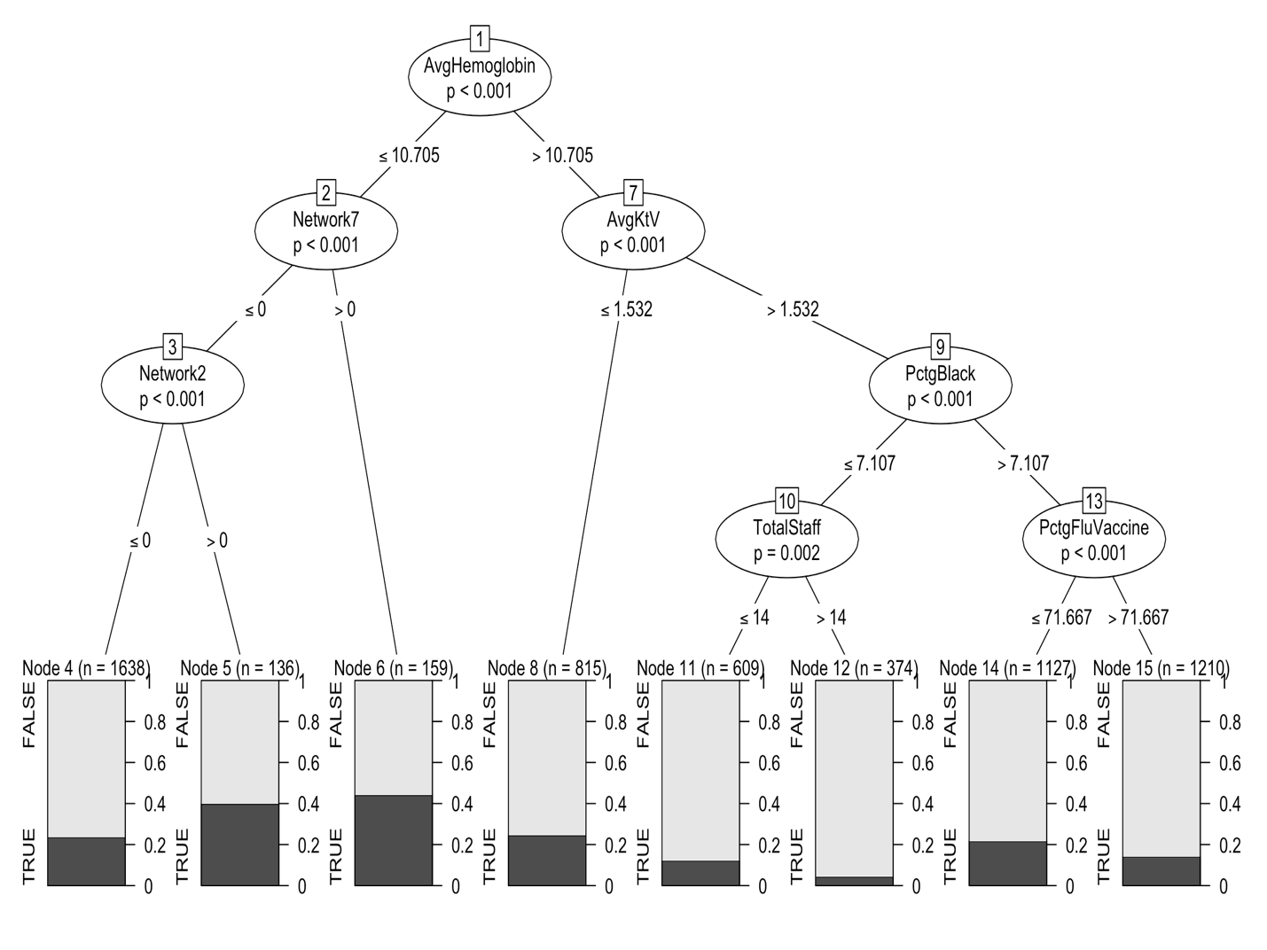
Conditional Inference Tree Cutoff 1.2072
Accuracy 0.7999
Prop. 0’s 0.7999
Much larger, but not any better classifier
Notes:
The conditional inference tree for predicting with a cutoff of 1.2072 is shown in figure 9. Although this tree is allowed to grow to 15 nodes, the accuracy is identical to that of the previous one-node tree (0.7999).

Slide 13
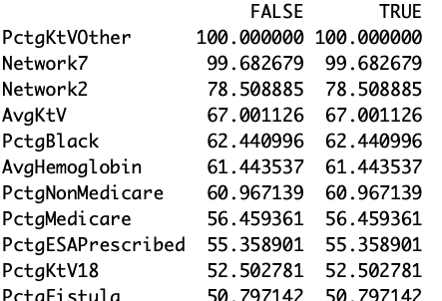
Variable Importance from CART RF Cutoff 1.2072
etc.
Perfect classification accuracy
10-fold CV accuracy 0.7998
Many more variables with importance > 50
Notes:
The variable importance values from running a CART random forest with cutoff 1.2072 are shown in figure 10. This model too demonstrates perfect classification accuracy, but again the 10-fold cross-validated classification accuracy of 0.7998 is comparable to that of the individual trees. The highest variable importance score is assigned to PctgKtVOther, followed by two factors of Network, AvgKtV, PctgBlack, AvgHemoglobin, PctgNonMedicare, PctgMedicare, PctgESAPrescribed, PctgKtV18, and PctgFistula. With a cutoff of 1.2072, there are many more variables with relatively high variable importance, in accordance with the general difficulty in using the given variables to predict SRR as observed in the decision trees.

Slide 14
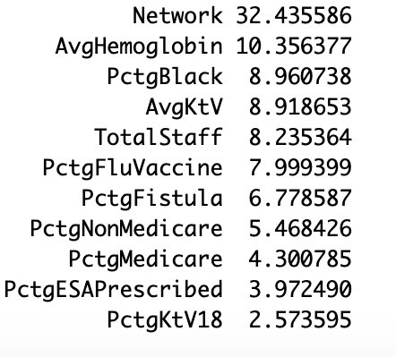
Relative Variable Influence from Boosting, Cutoff 1.2072
Same trend as before – Network most influential
Notes:
Same trend as before – Network most influential variable, followed by others that were already selected

Slide 15
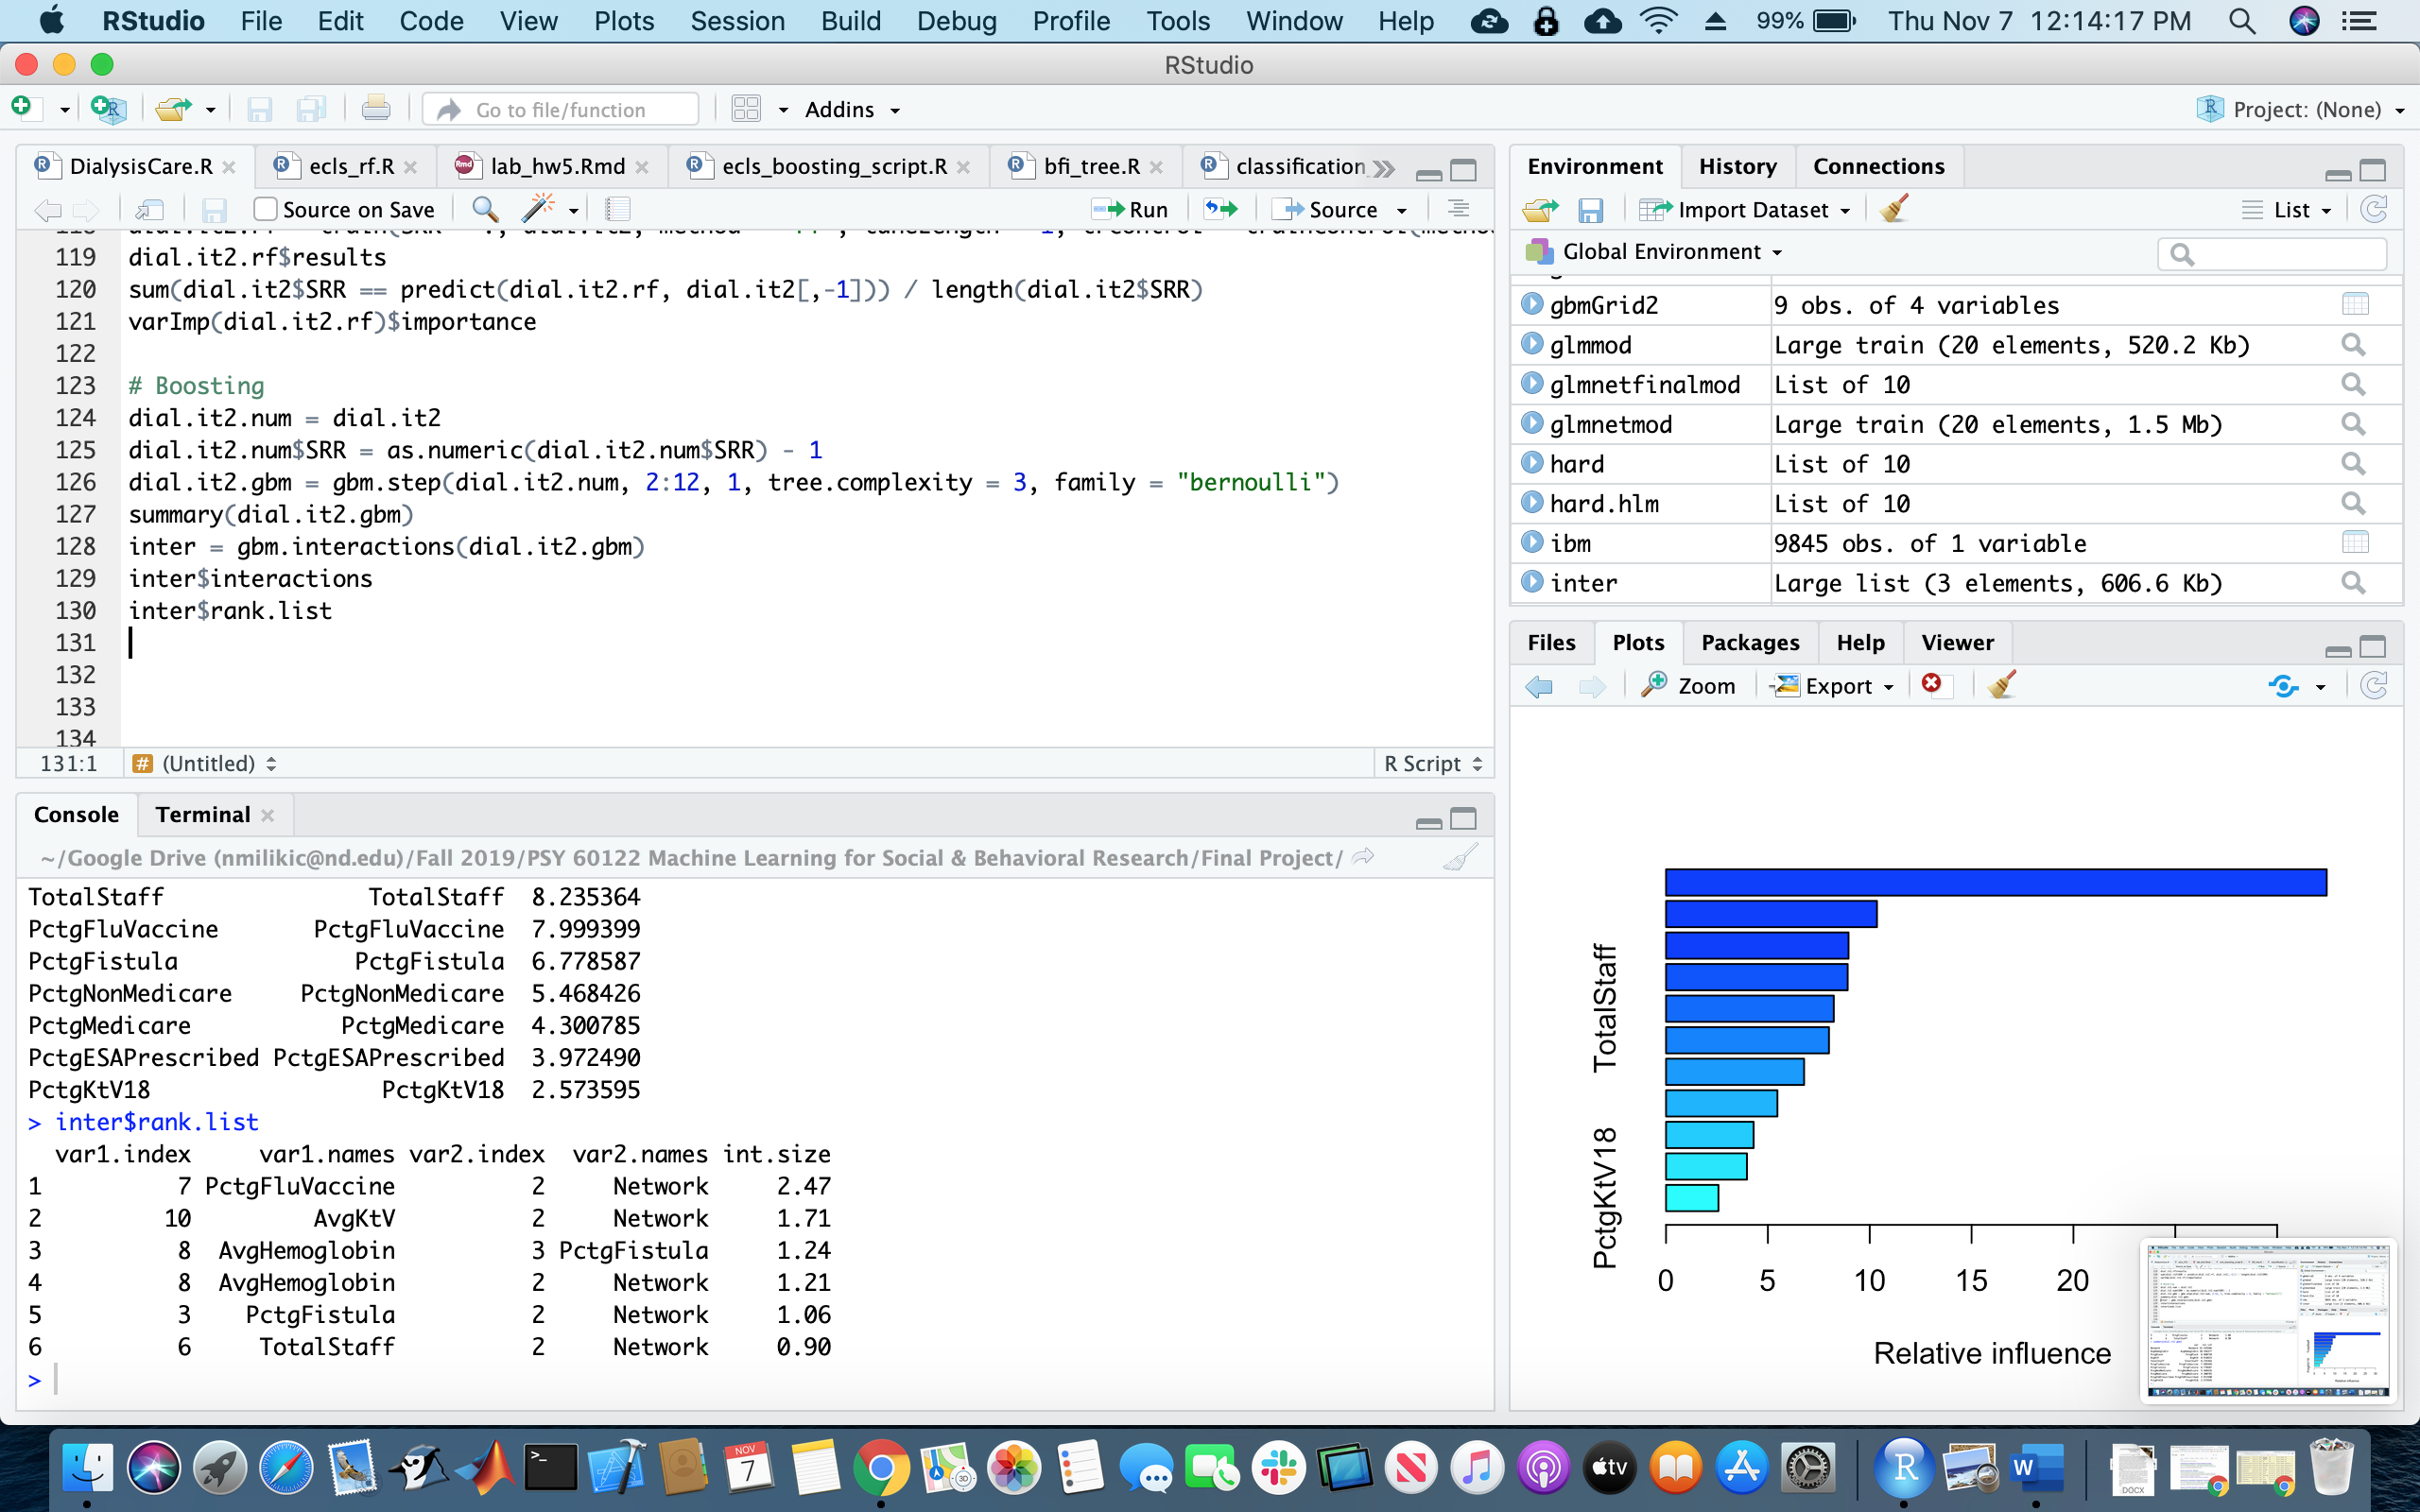
Variable Interactions from Boosting, Cutoff 1
Similar interactions between Network and 5 other variables
Consistent with high importance but absence from selection

Slide 16
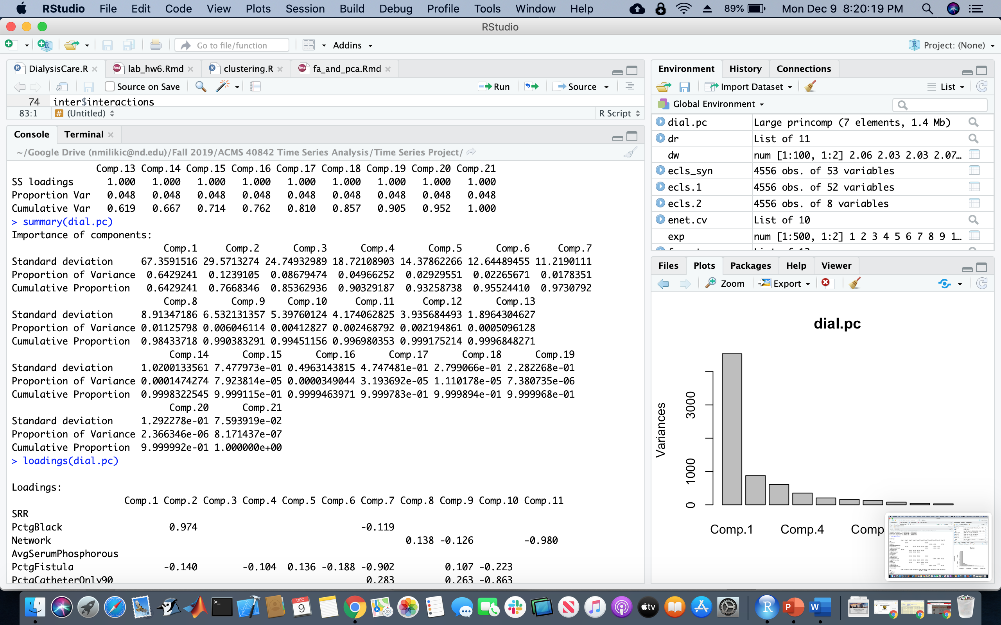
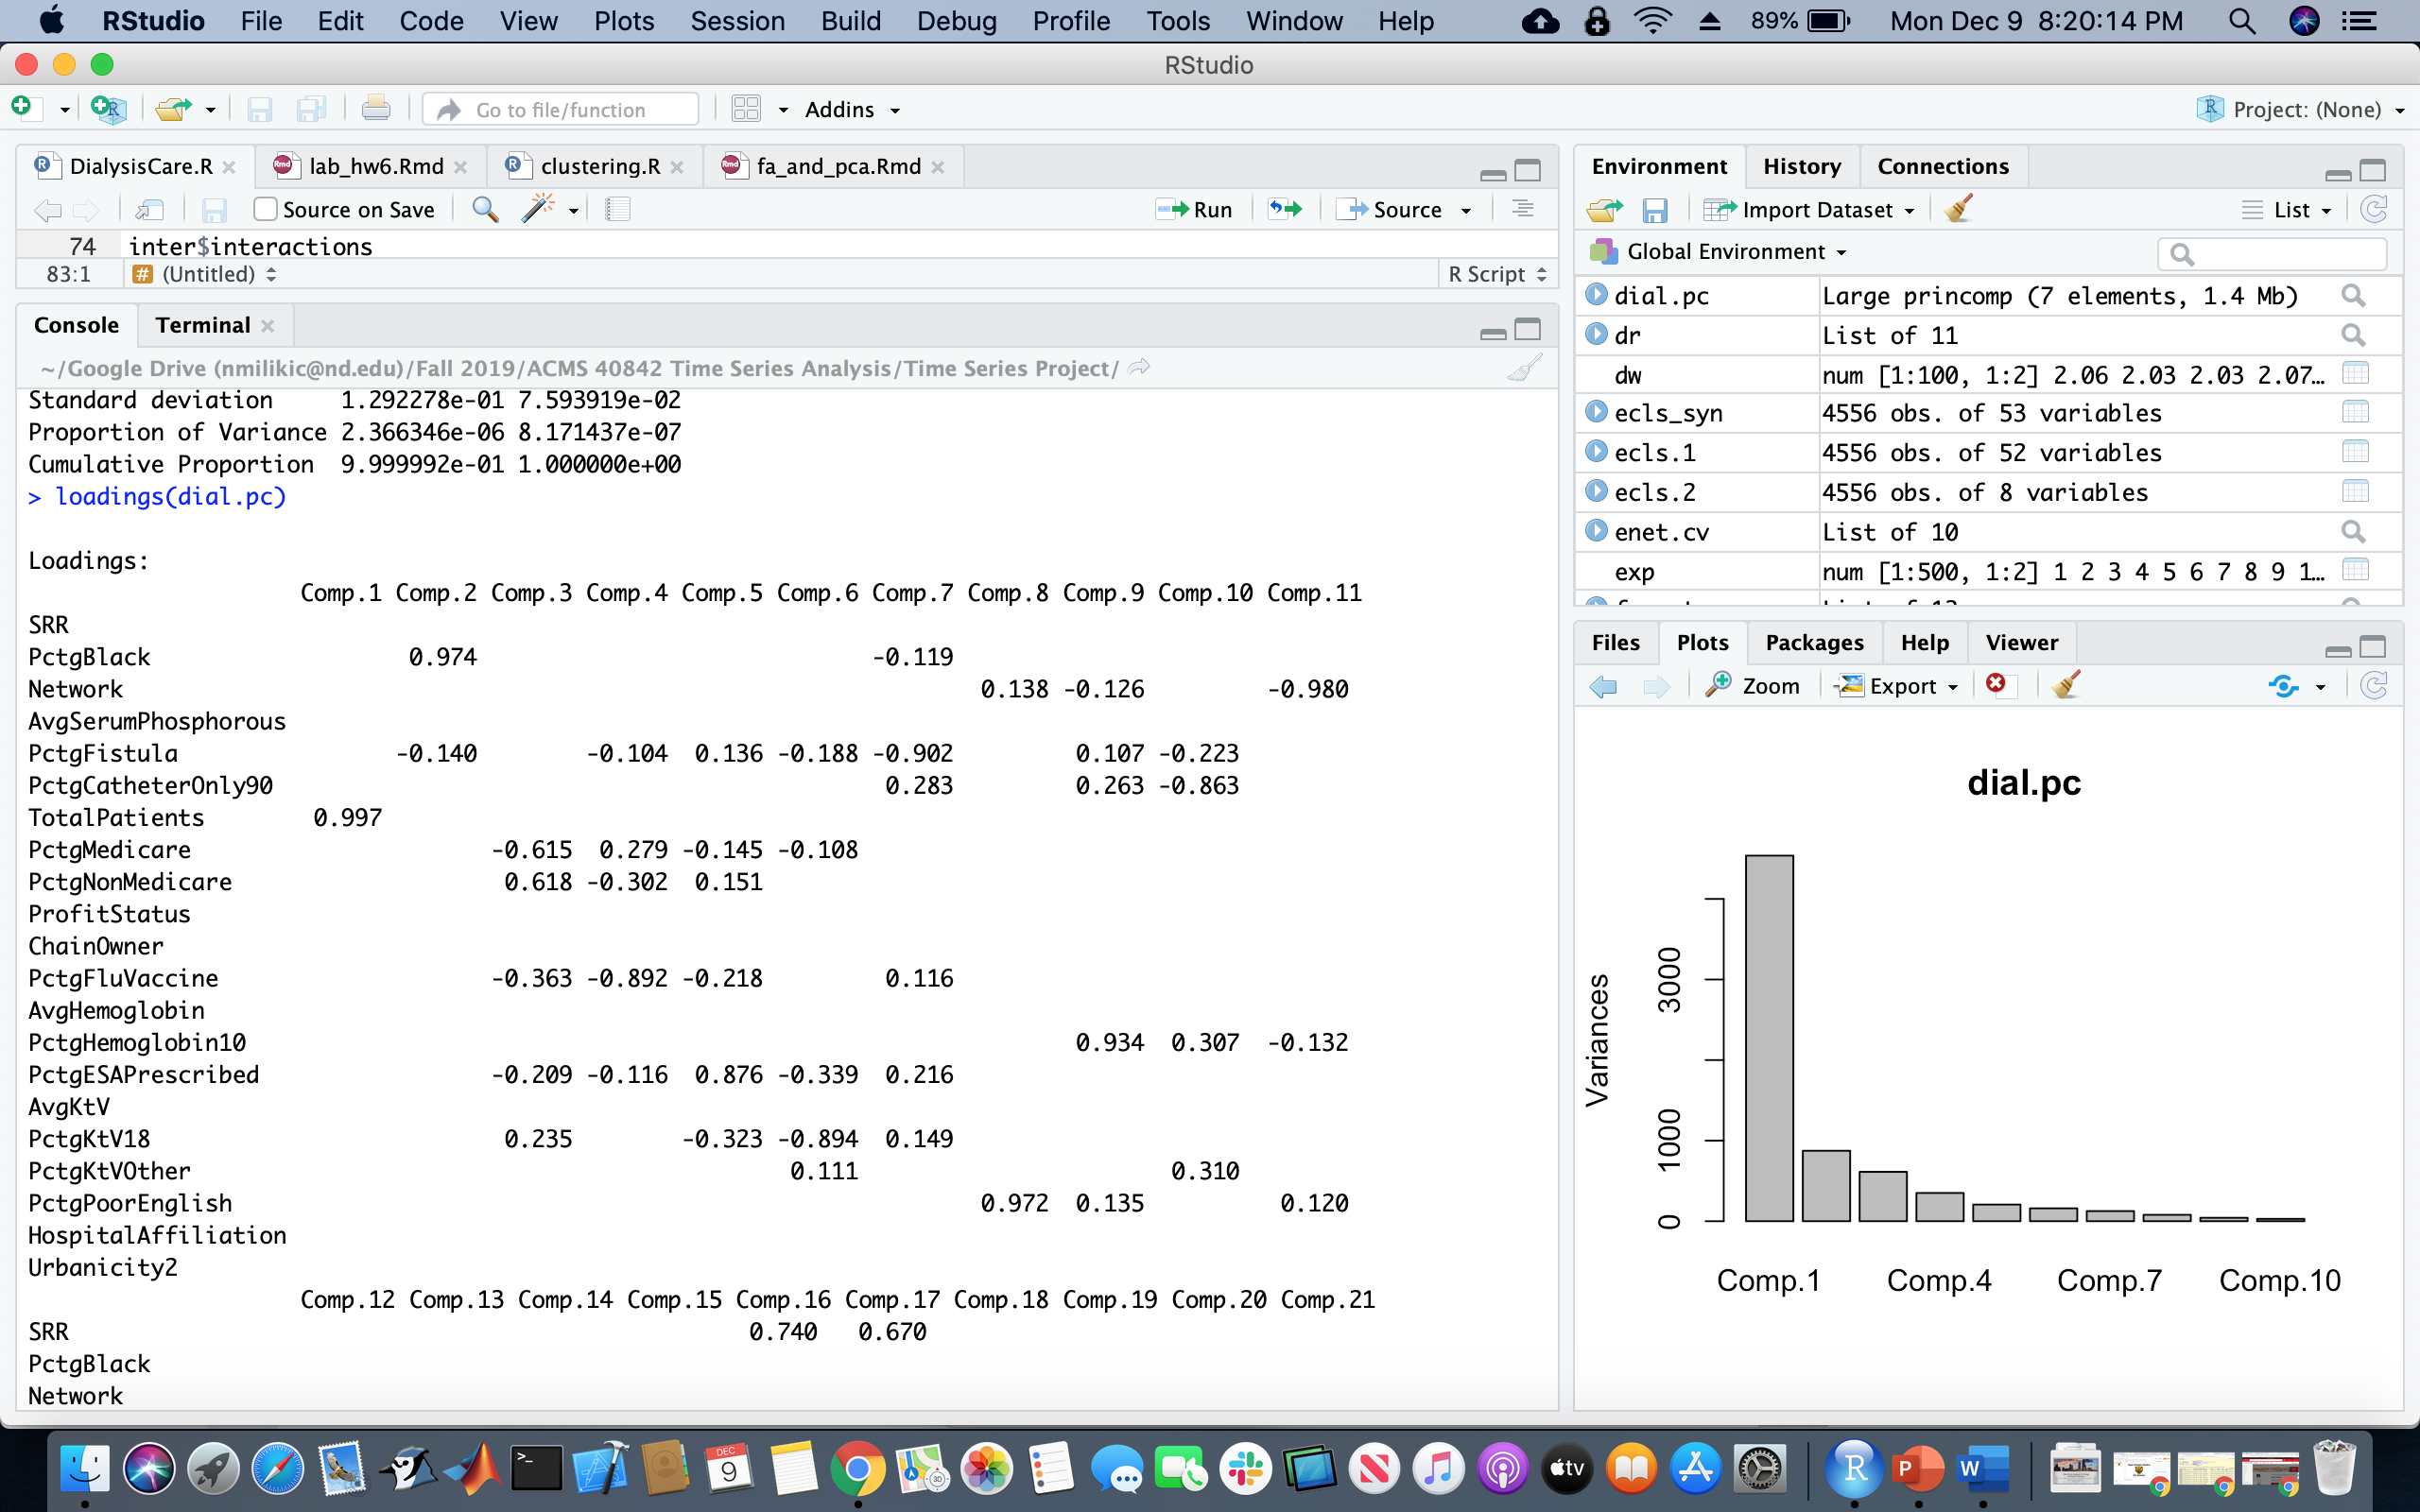
Principal Components

Slide 17
Discussion
Strong interactions between Network and 5 other variables
Performance differs based on geographic location
Difficult to separate performance from demographic factors that might be affecting performance (patient education, income, overall health, etc.)
Notes:
Strong interactions were identified between Network and each of PctgFluVaccine, AvgKtV, AvgHemoglobin, PctgFistula, and TotalStaff, suggesting that the performance of dialysis facilities differs based on geographic location. Again, it seems that it is difficult to separate dialysis performance from demographic factors that might be affecting performance, such as patient education, income and overall health, etc.

Slide 18
Variables Chosen for Nodes
 | CART (1) | Conditional Inference (1) | CART (1.2072) | Conditional Inference (1.2072)
Biological Markers | AvgHemoglobin PctgESAPrescribed PctgFluVaccine | AvgHemoglobin AvgKtV PctgHemoglobin10 |  | AvgHemoglobin AvgKtV PctgFluVaccine
Demographic | PctgBlack | Network PctgBlack TotalPatients Urbanicity2 |  | Network PctgBlack TotalStaff
Biological markers – many related to hemoglobin/anemia
Demographics – likely not causal wrt. SRR
Notes:
The variables chosen for nodes in each of the four decision trees created are shown in table 1 organized into variables that describe biological markers and those that describe demographic data. In terms of biological markers, facilities whose patients have a higher average hemoglobin count (AvgHemoglobin) and higher average Kt/V (clearance time per volume, AvgKtV) tend to experience a lower SRR (better performance). Facilities with a lower percentage of patients with low hemoglobin (PctgHemoglobin10), a lower percentage of patients who have been prescribed erythropoietin-stimulating agents to treat erythropoietin-deficient anemia related to CKD (PctgESAPrescribed), and a higher percentage of patients who have received their flu vaccine (PctgFluVaccine) tend to experience a lower SRR. The inclusion of these metrics as opposed to the many others in the complete data set suggests that dialysis facilities might closely monitor patients who have or are at risk for anemia (in addition to the performance of their dialysis procedures in the form of clearance time per volume and the overall health of their patients in the form of patient vaccination) in order to improve care and lower their SRR.
In terms of demographic data, facilities with a lower percentage of black patients (PctgBlack), fewer total patients (TotalPatients) and total staff (TotalStaff), facilities that are rural (Urbanicity2), and facilities in certain networks (Network) tend to experience a lower SRR. It appears counterintuitive that facilities with smaller staffs have better performance, but it is likely that facilities that are smaller simply tend to perform better. These demographic data are certainly not causal with respect to SRR; it is more likely that these underlying demographic variables are responsible for both poor performance on biological metrics and on SRR. It might be advantageous, at the risk of stating the obvious, for owners of dialysis facilities to invest in their facilities in lower-income areas in order to improve patient care and facility performance as assessed by SRR.

Slide 19
Conclusions
High variability – difficult to predict with reasonable accuracy
At 1.2072 cutoff, not a single tree improved accuracy
High variability in individuals compounded
Investigate how similar variables might be grouped
Ex: AvgHemoglobin, PctgHemoglobin10, PctgHemoglobin10t11, PctgHemoglobin11t12, PctgHemoglobin12, and PctgESAPrescribed
Notes:
Overall, the variability in the data is such that it is extremely difficult to fit any model that predicts SRR with any reasonable efficiency. For example, with a cutoff of 1.2072 no decision trees were found that raised the classification accuracy of SRR over that of a null model. Individual patients already represent a great deal of variability, and when adding across patients at the facility level it seems that the variability becomes so great that it remains possible to identify some trends but becomes nearly impossible to predict new cases with any useful accuracy. Moving forward, both for simplicity of prediction and to reduce some of the variability, it might be useful to investigate how variables describing similar measurements might be grouped. For example, some linear or nonlinear combination of the variables AvgHemoglobin, PctgHemoglobin10, PctgHemoglobin10t11, PctgHemoglobin11t12, PctgHemoglobin12, and PctgESAPrescribed might be added to the model as a measure of overall patient health as it relates to hemoglobin/anemia.

Slide 20
References
Assimon, M. M., & Flythe, J. E. (2017). Thirty-day hospital readmissions in the hemodialysis population: A problem well put, but half-solved. Clinical Journal of the American Society of Nephrology : CJASN, 12(10), 1566-1568. doi:10.2215/CJN.08810817
Chan, L., Poojary, P., Saha, A., Chauhan, K., Ferrandino, R., Ferket, B., et al. (2017). Reasons for admission and predictors of national 30-day readmission rates in patients with end-stage renal disease on peritoneal dialysis. Clinical Kidney Journal, 10(4), 552-559. doi:10.1093/ckj/sfx011
Hickson, L., Thorsteinsdottir, B., Ramar, P., Reinalda, M., Crowson, C., Williams, A., et al. (2018). Hospital readmission among new dialysis patients associated with young age and poor functional status. Nephron, 139(1), 1-12. doi:10.1159/000485985
Romancito, G. (2018). Hemodialysis. Retrieved 7 Nov, 2019, from https://www.niddk.nih.gov/health-information/kidney-disease/kidney-failure/hemodialysis
Report for the standardized readmission ratio (2017). The University of Michigan Kidney Epidemiology and Cost Center.
Wang, J. (2018). RMU dissertation - final data file Kaggle, Inc.,
from https://www.kaggle.com/wcj365/rmudsc2

